Slide 1



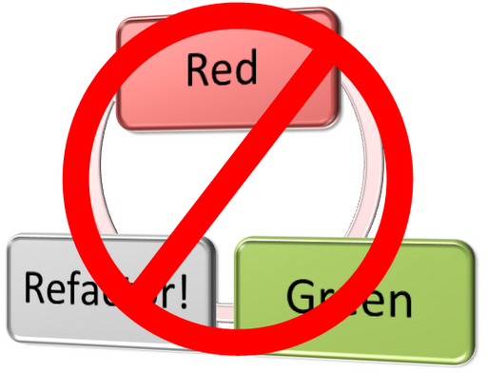
Test-Driven Development
Learn the "Test First"
Approach to Coding
Svetlin Nakov
Technical Trainer
www.nakov.com
Software University
http://softuni.bg

Slide 2

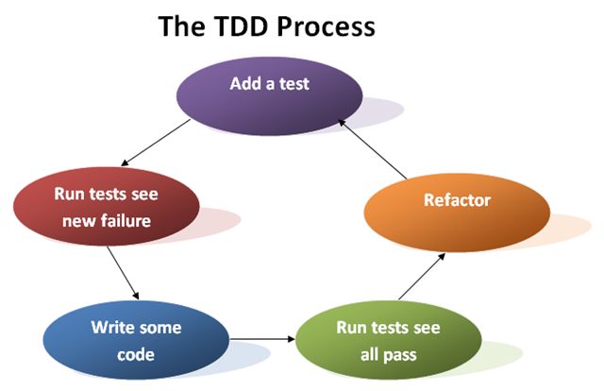
Code and Test vs. Test Driven Development

Slide 3
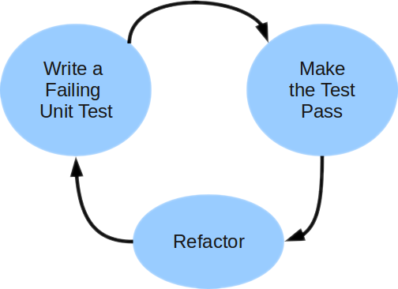
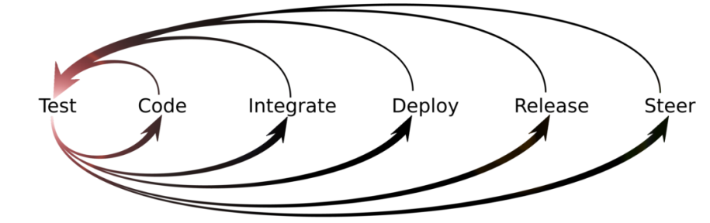
Unit Testing Approaches
"Code First" (code and test) approach
Classical approach
"Test First" approach
Test-driven development (TDD)

Slide 4
Code and Test Approach
Write code
Write unit test
Run and succeed
Time flow

Slide 5
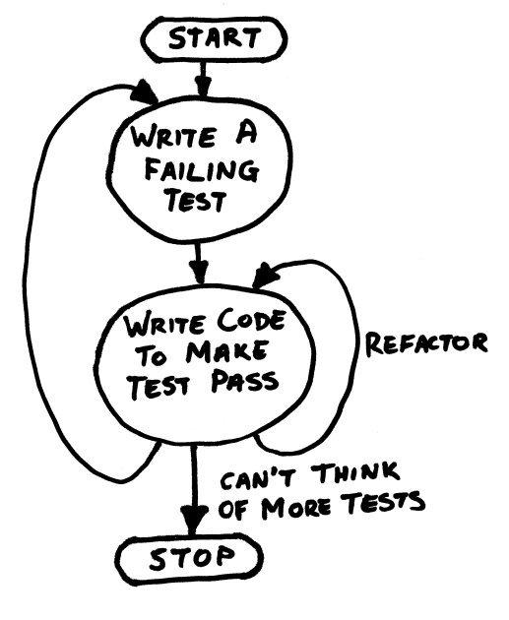
TDD in One Slide

Slide 6
Test-Driven Development (TDD)
Create a test list
Pick а test
Write test
Compile and fail
Write enough code to compile
Run test and fail
Write code to pass test
Time flow
Remove duplication

Slide 7


Why TDD?
TDD helps find design issues early
Avoids rework
Writing code to satisfy a test is a focused activity
Less chance of error
Tests will be more comprehensive than when written after code

Slide 8
Myths and Misconceptions
You create a 100% regression test suite
The unit tests form 100% of your design specification
You only need to unit test
TDD is sufficient for testing
TDD doesn't scale (partially true)
Your test suite takes too long to run
Not all developers know how to test
Everyone might not be taking a TDD approach

Slide 9
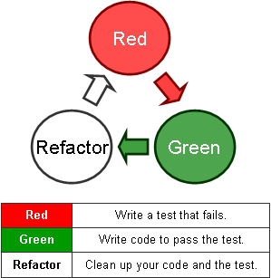
Test-Driven Development
Live Demo: Poker Hands Checker

Slide 10







Test-Driven Development
https://softuni.bg/courses/high-quality-code/

Slide 11

License
This course (slides, examples, demos, videos, homework, etc.) is licensed under the "Creative Commons Attribution-NonCommercial-ShareAlike 4.0 International" license
Attribution: this work may contain portions from
"High Quality Code" course by Telerik Academy under CC-BY-NC-SA license

Slide 12





Free Trainings @ Software University
Software University Foundation – softuni.org
Software University – High-Quality Education, Profession and Job for Software Developers
softuni.bg
Software University @ Facebook
facebook.com/SoftwareUniversity
Software University @ YouTube
youtube.com/SoftwareUniversity
Software University Forums – forum.softuni.bg

